Slide 1
STANCE DETECTION IN TWEETS
NLP GIANTS:
Bharath Chandra Reddy(M12510331)
Rachit Aggarwal(M12506500)
Kowshik Bhowmik(M10584257)
Krishna Sai Patnana(M12483628)

Slide 2
What is Stance Detection?
Stance detection is the process of detecting the stance of the person on a particular subject/target.
We are going to detect from a person’s tweet if he/she is in favor or against a given target entity.

Slide 3
Stance Detection is different from Sentiment analysis in a way that in Sentiment analysis we detect the emotion of a person which varies from positive to negative, whereas in Stance Detection we identify the stance which can be Favor, Against or Neutral. A person can be negative in sentiment towards another entity, but could be favoring the target.

Slide 4
Our task includes two sub-tasks based on Supervised learning and weak Supervised learning.
The task we address is about classifying the given tweets under three labels Favor, Against or Neutral. Task is divided into two sub tasks where one involves supervised learning other uses weak-supervised learning.
For the first task we are provided with training data having five different target entities and the tweets have predefined labels for stance

Slide 5
For the second subtask we have only one target entity. Weak-supervised learning will be implemented on a huge unlabeled data to detect the correct stance for the target entity.
Our goal is to use the provided training data for both subtasks to train our model for stance detection.

Slide 6
The approach we have come up with so far, for stance detection is distributed into the following steps:
Pre-Processing
Feature Selection
Classification

Slide 7
Pre-Processing
This stage involves :
Separation of Hashtags,
Elimination of punctuations, and
Conversion of slangs and abbreviations into their correct forms from the training corpus.

Slide 8
Since the training model might encounter problem in interpreting the correct meaning of them, we separated all the hashtags from the tweets and collected them separately along with the unique id’s of each tweet.
The tweets in our training corpus also has many unnecessary and incorrect punctuations which includes multiple occurrences of the same symbol. We removed all the punctuations from the tweets to clean the data.

Slide 9
The character limit in Twitter restricts people to use limited characters to express their opinion. Due to this people are more inclined to using abbreviations and slangs to write less but convey more with their tweets.
Since the Stance detection is not capable to recognize the correct form of these words, we have used a pre-defined dictionary which consists of slangs/abbreviations and their respective correct form to perform this step.

Slide 10
Feature Selection and extraction
Our approach is to handpick a handful of topics that are closely related to our targets and use the associated sentiments of the overall tweet along with them.
We have taken the clean tweets from the preprocessing phase to extract features from them. For the project proposal, we are using bigrams as features. We have taken the most common 500 bigrams from the training set data to build our feature set. We have also tried using bag of words for the feature selection.

Slide 11
Classification
Although the stance detection task is about classifying the tweets into ‘Favor’ & ‘Against’ class, in the training data there are tweets that have the label ‘None’ also.
At this point in our project we have classified into the three classes. Later we will introduce a two-layer classifier.
We have used the Multinomial Naïve Bayes , classifiers provided by the scikit-learn package wrapped by the nltk package.

Slide 12
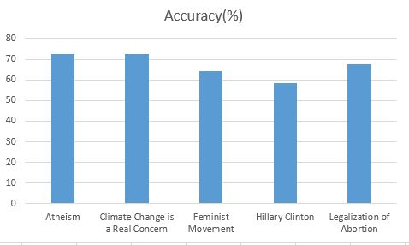
Preliminary Results

Slide 13
Future Work
Using hashtags as features, classified as positive and negative with respect to target entity
Using the overall sentiment value of each tweet as feature. (using AFINN dictionary)
Incorporate Target related entities, where we identify entities relevant to target entities and classify them as favor or against and use them as features.
Try new classification algorithms.

Slide 14
Timeline
Week 1 :
Make changes in programming and preparation for Task-B.
Week 2:
Feature Selection and Extraction. Include hashtags in the clean data and perform sentiment analysis and incorporate target related entities.
Week 3:
Research and exploration.
Week 4
Trying out different Classifiers and zeroing in on the right one.

Slide 15
Week 5:
Trail run and working on final changes.
Week 6:
Prepare the final report and make sure that everything is in place.

Slide 16
Work Distribution
Data Preprocessing
The Data pre-processing which includes: Separation of Hashtags, Elimination of Punctuation and Conversion of Slangs and Punctuation was done by Rachit Aggarwal and Bharath Chandra Reddy.
Feature Selection and Classification
The feature selection and classification which includes incorporation of Bi-grams and classifiers was done by Kowshik Bhowmik and Krishna Sai Patnana.

Slide 17
The Report and Presentation was a combined effort by all the group members.

Slide 18
THANK YOU

